Slide 1
Working with Issues Related to Relationship, Gender Identity, and Sexuality in Individuals with Autism Spectrum Disorders
Joseph Falkner, MST/CCC-SLP
MACMH Presentation, April 25th, 2017

Slide 2
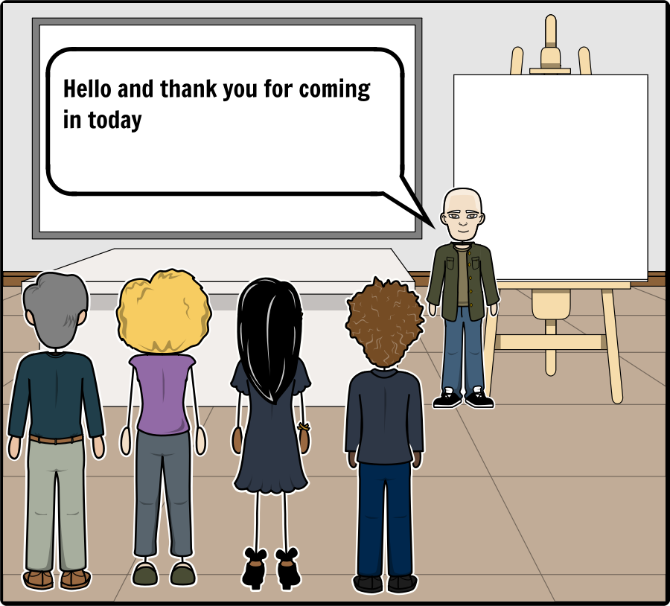
Introduction
Add Text Here
Romantic relationships are something that many of us on the spectrum may struggle with. They can be very complex, and also very rewarding. But the process can be especially challenging for those on the spectrum. The dating world is rife with unspoken rules and expectations, and can be difficult for even the most skilled among us to navigate. Add strong feelings into the mix and it can get pretty daunting. (Soraya, 2013)

Slide 3
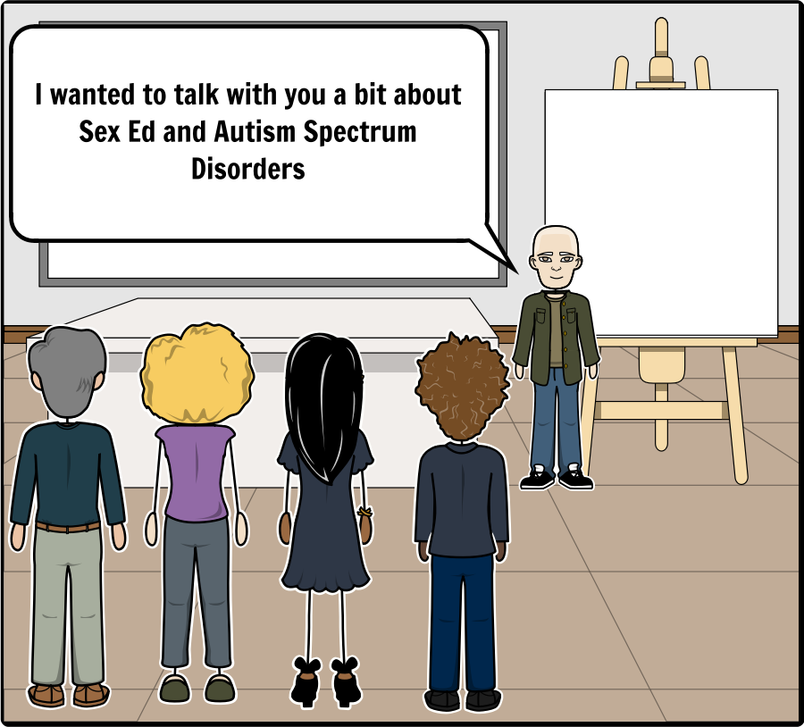
Introduction
Add Text Here
…sexuality is an integral part of the normal development of adolescents and we have recently begun to recognize that individuals (with ASD) have the right to experience and fulfill this important part of their life. (Henault, 2016)

Slide 4
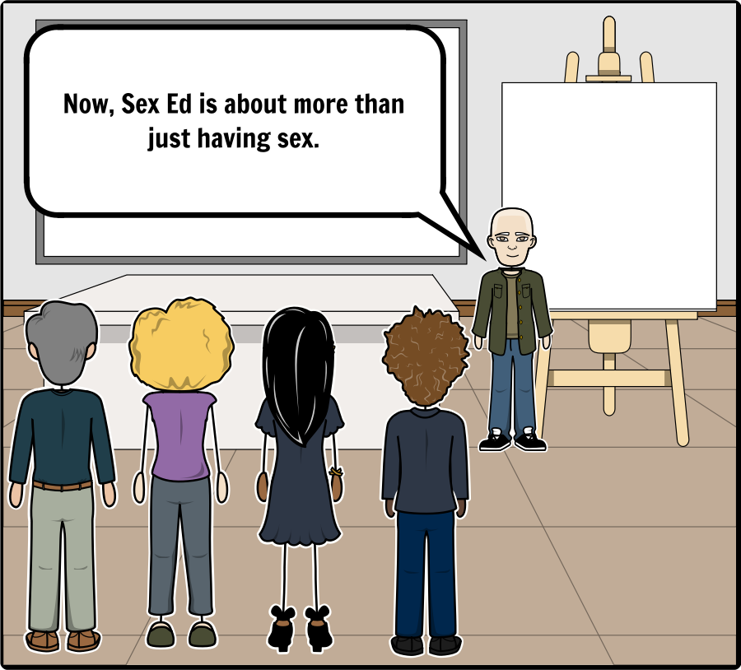
Introduction
Add Text Here

Slide 5
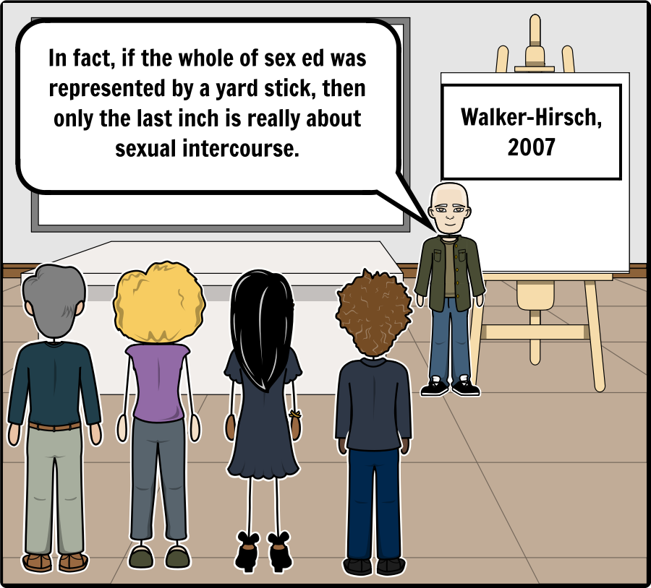
Introduction
Add Text Here
Sexual Health is “…a state of physical, emotional, mental and social well‐being in relation to sexuality; it is not merely the absence of disease, dysfunction or infirmity. Sexual health requires a positive and respectful approach to sexuality and sexual relationships, as well as the possibility of having pleasurable and safe sexual experiences, free of coercion, discrimination and violence. For sexual health to be attained and maintained, the sexual rights of all persons must be respected, protected and fulfilled.” (WHO, 2006a)

Slide 6
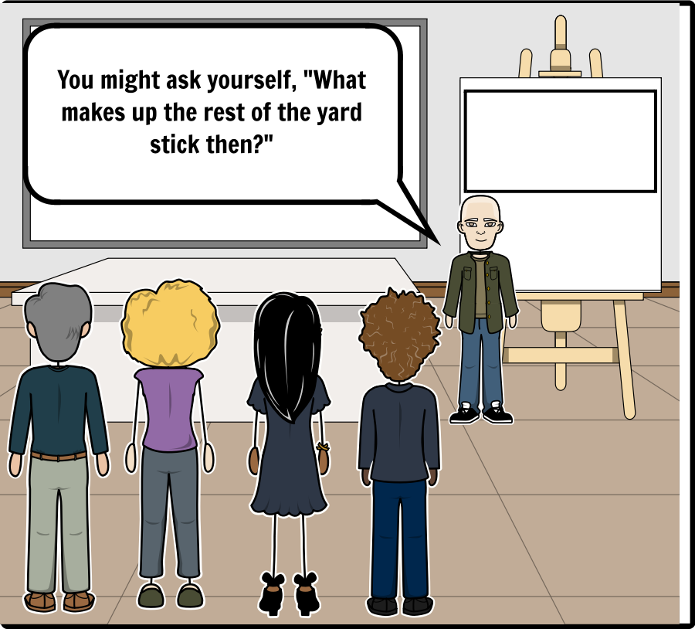
Introduction
Add Text Here
…sexuality in AS consists of intimacy, friendship, pleasure, communication, love, masturbation, intercourse, dating, desire, identity and belonging in addition to problematic behaviors. (Henault, 2016)

Slide 7
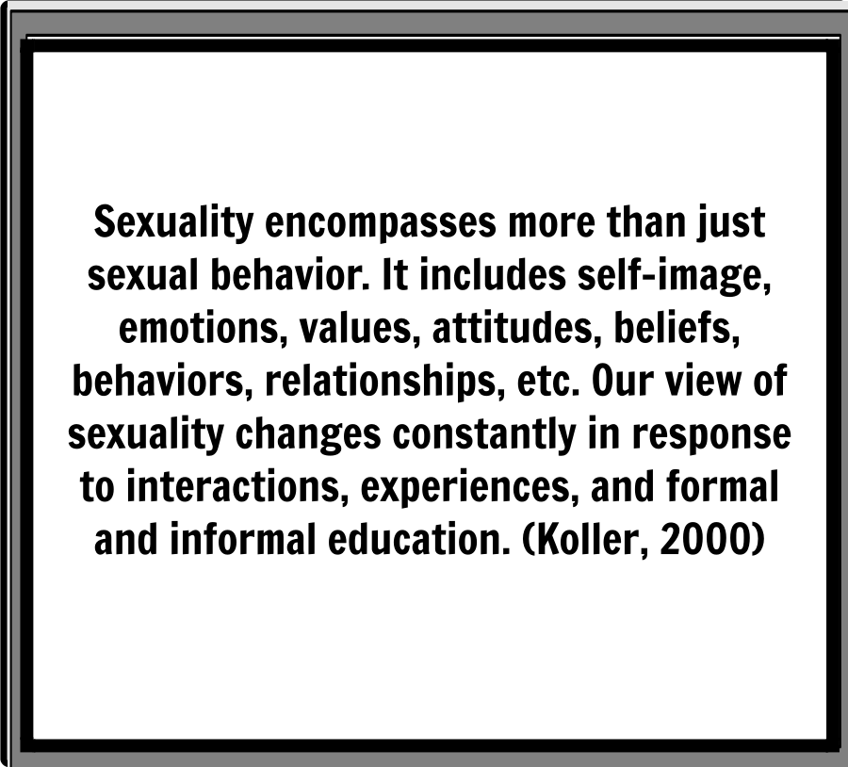
Introduction
Add Text Here

Slide 8
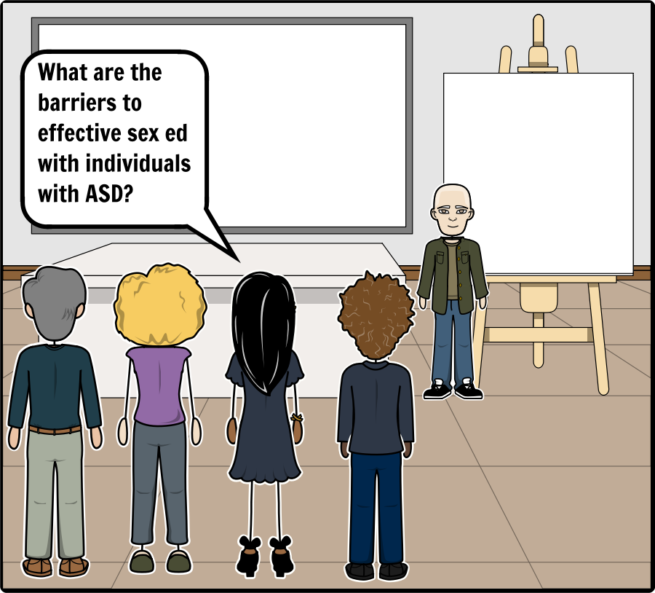
Barriers
Add Text Here
Youth with disabilities, due to segregated programs in schools, different learning styles, and an assumption on the part of parents and teachers that sexuality and disability are somehow incongruous, are often even further denied sexuality education. (Mainella, 2015)

Slide 9
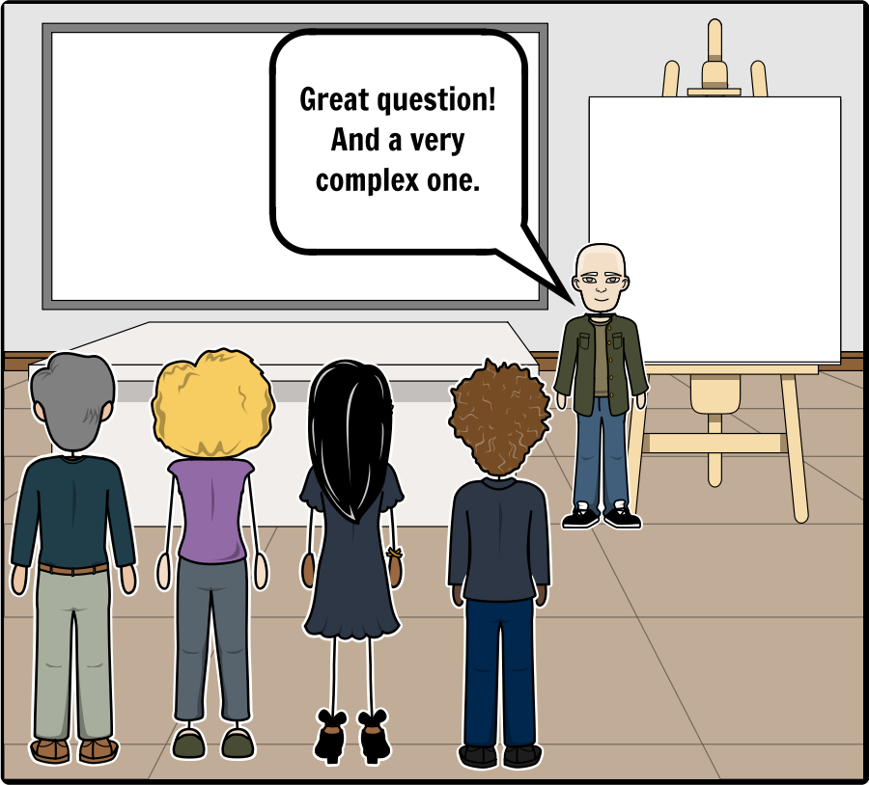
Barriers
Add Text Here
Because of this inability to access information, youth with disabilities are more prone to become victims of abuse and sexual assault and may be unable to make informed decisions about their sexual health, which can then cause disproportionate rates of teen pregnancies and sexually transmitted infections. (Mainella, 2015)

Slide 10
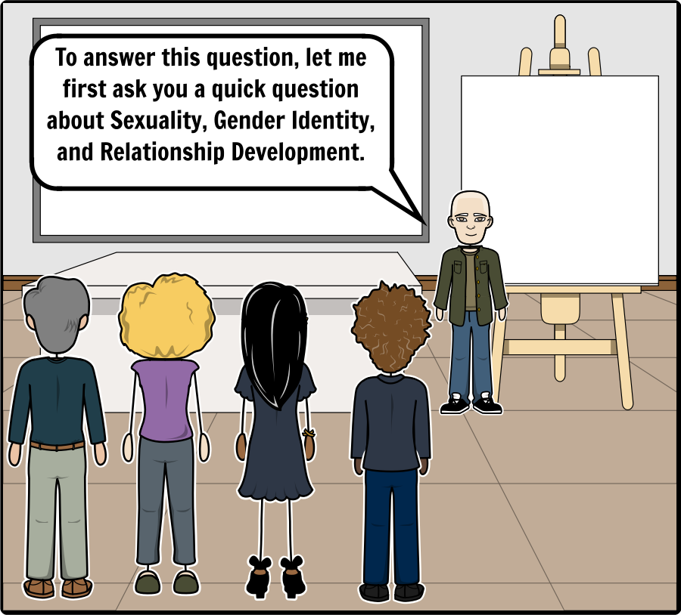
Barriers
Add Text Here

Slide 11
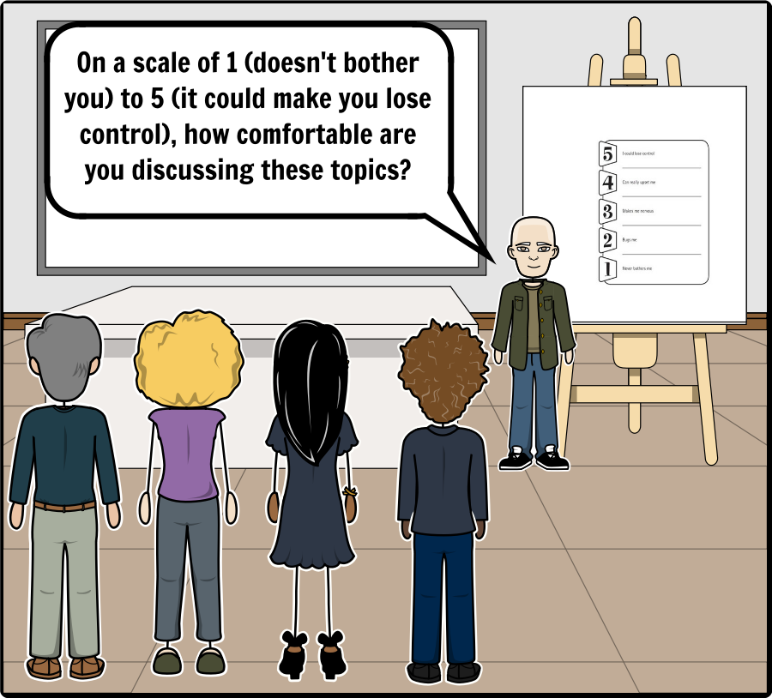
Barriers
Add Text Here

Slide 12
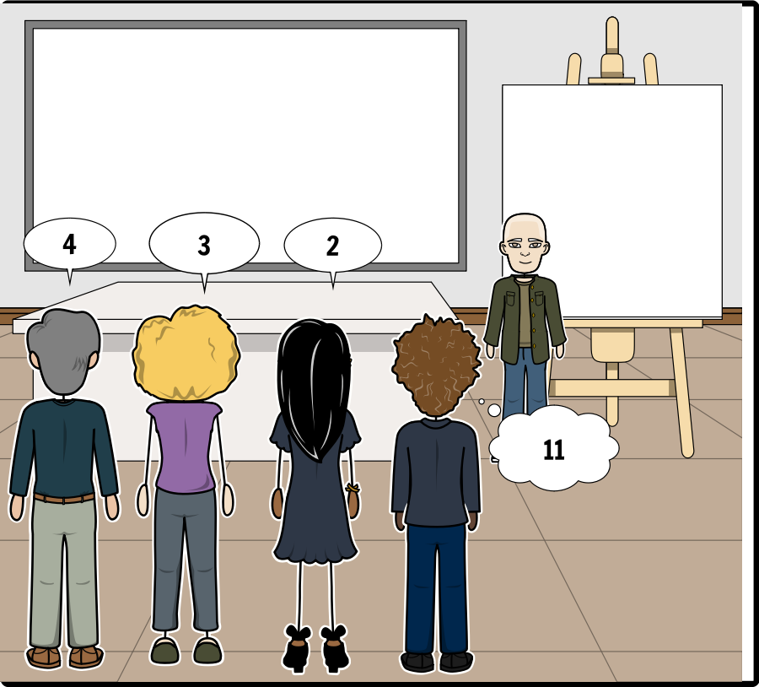
Barriers
Add Text Here

Slide 13
Barriers
Add Text Here

Slide 14
Ableism
Add Text Here
When the views of the public influence too strongly the delivery of services, it can hinder or significantly limit the quality or type of instructional provision provided, leaving a gap in knowledge for this group. ‘Many adolescents with disabilities receive inadequate information about sexuality or do not understand the information presented. (Tissot, 2009)

Slide 15
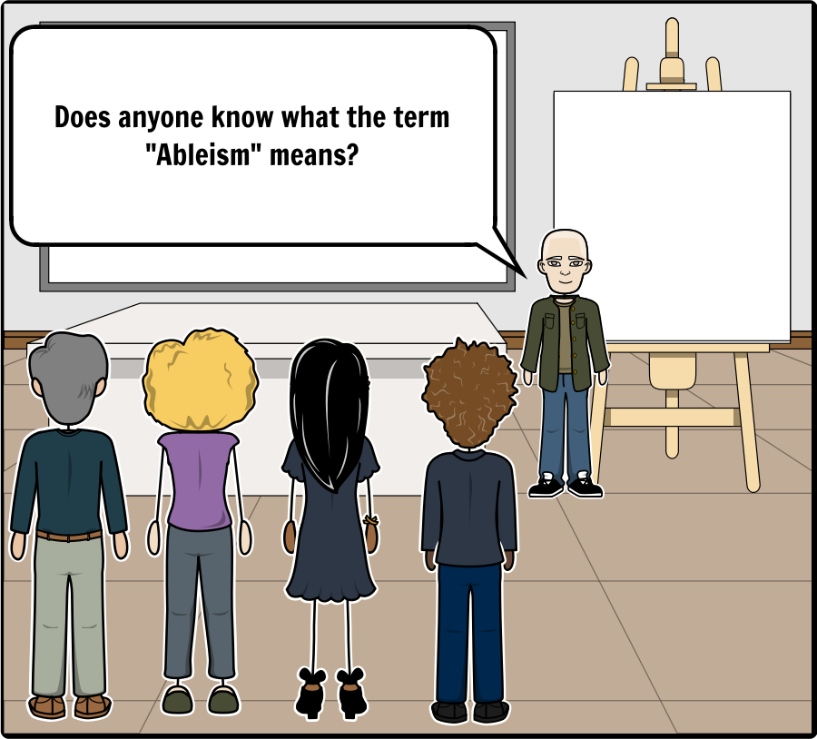
Ableism
Add Text Here
The issue of sexuality cannot be separated from the issue of segregation. There is no denying that the 'differentness' of people with disability leads people to fear, and in this case the fear is based, at least partially, on attitudes towards sexuality of people with disabilities. (Hingsburger 1995, p.26}

Slide 16
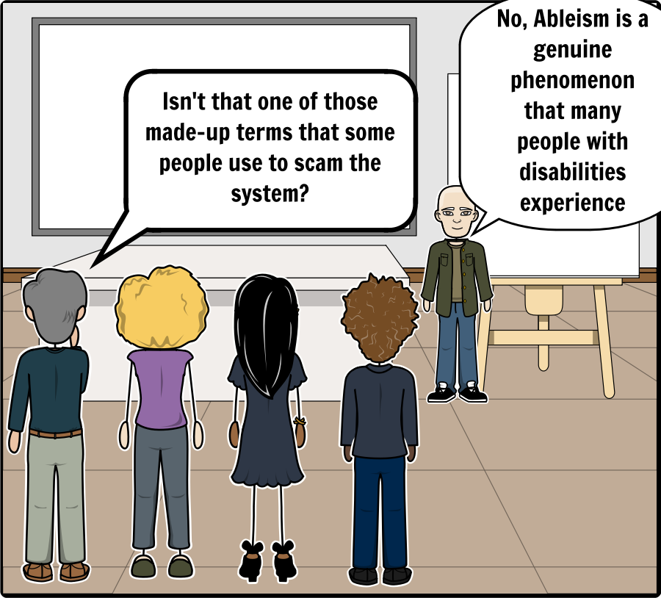
Ableism
Add Text Here
Structural ableism: refers to experiences generated through the implementation of social structures that privilege particular abilities and the people who demonstrate them at the expense of those who do not. (Barrett, 2014)

Slide 17
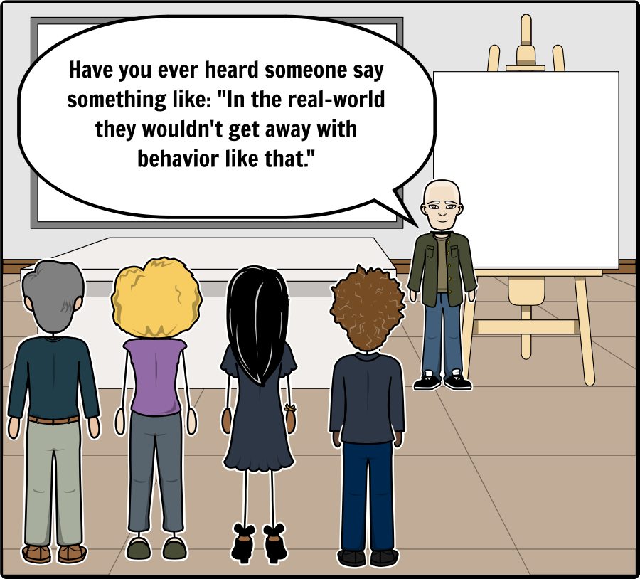
Ableism
Add Text Here
Examples (Barrett, 2014)
the construction and organization of public spaces that do not accommodate sensory differences (e.g. fluorescent lighting at work);
inadequate access to health care, especially for ASD‐‐related services, sexual/reproductive health, and medical transitioning (i.e. body modifications to change one's gendered appearance or legal sex);
inadequate legal representation and/or accommodation during police and legal proceedings;

Slide 18
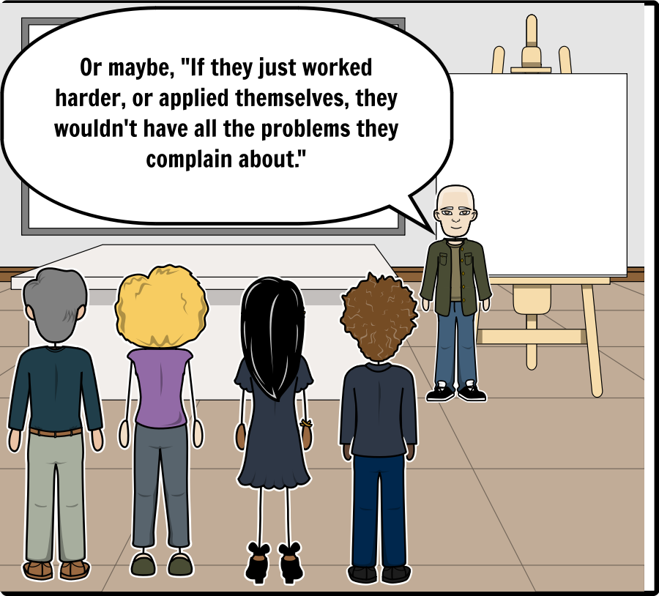
Ableism
Add Text Here
Cultural ableism: refers to experiences generated by the exercise of social norms and cultural beliefs that value particular abilities and the people who demonstrate them at the expense of those who do not. (Barrett, 2014)

Slide 19
Ableism
Add Text Here
Examples (Barrett, 2014)
the belief that only neurotypical persons are capable of making informed decisions;
the pervasive experience of being misunderstood due to the privileging of neurotypical ways of experiencing, understanding, and communicating about the world;
paternalistic treatment (e.g. talking to participants as if they were children);

Slide 20
Ableism
Add Text Here
AS individuals are often perceived as lifelong asexual children. This leads to overprotection and ''over‐sexualization'' of the AS individual in response to the restrictions and limitations imposed by the environment. The risk is that the AS person may then act impulsively, without considering the environmental limits. (Henault, 2014)

Slide 21
Ableism
Add Text Here
Professionals sometimes tend to think they have the right to manage the sexual behavior of people with AS, without consulting the individual. (Henault, 2014)

Slide 22
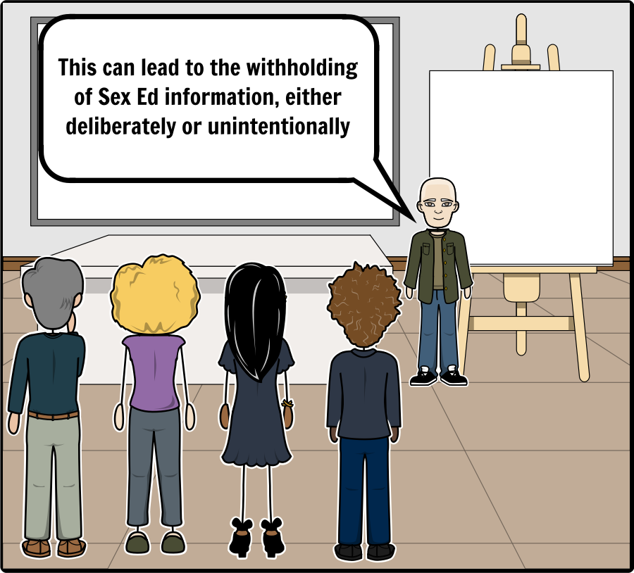
Ableism
Add Text Here
The prison of protection is built of kindness. When we service providers see someone as being ‘vulnerable’ because of who they are we come protectors. There are four walls to the prison. The walls are built to protect the person, who is seen as vulnerability encased in flesh. (Hingsburger, 1995)

Slide 23
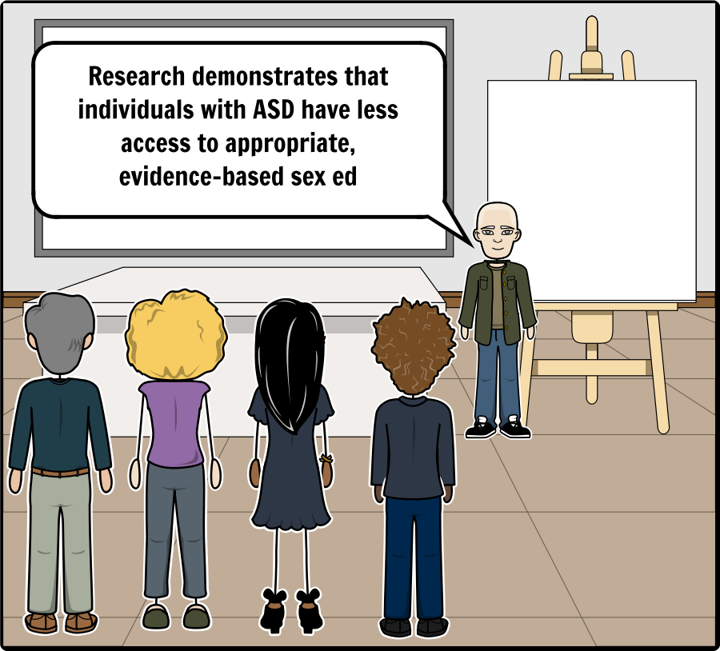
Ableism
Add Text Here
If youth in the general population suffer ill effects from lack of education, youth with disabilities certainly do. (Mainella, 2015)

Slide 24
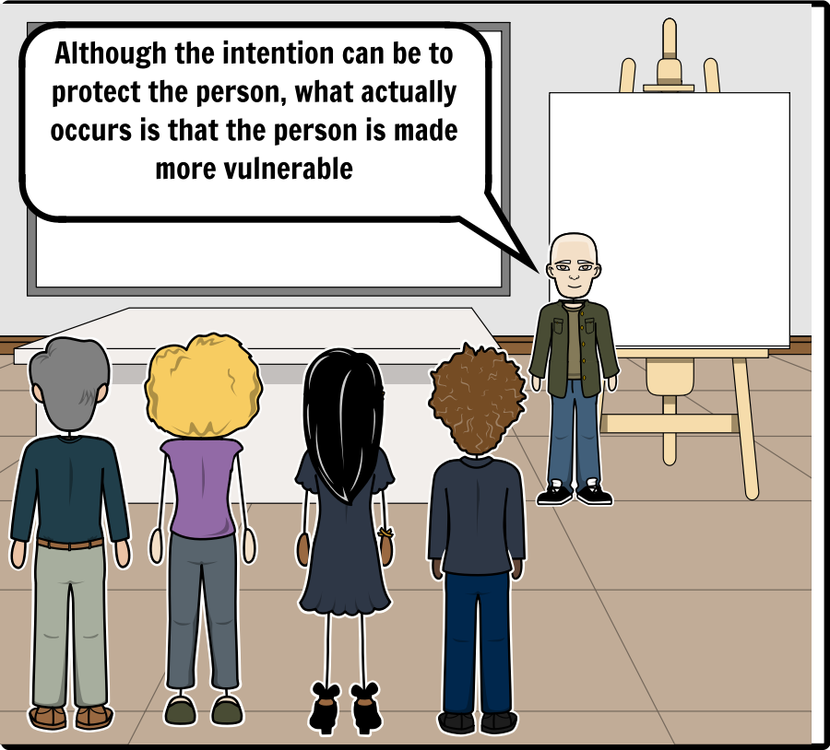
Ableism
Add Text Here

Slide 25
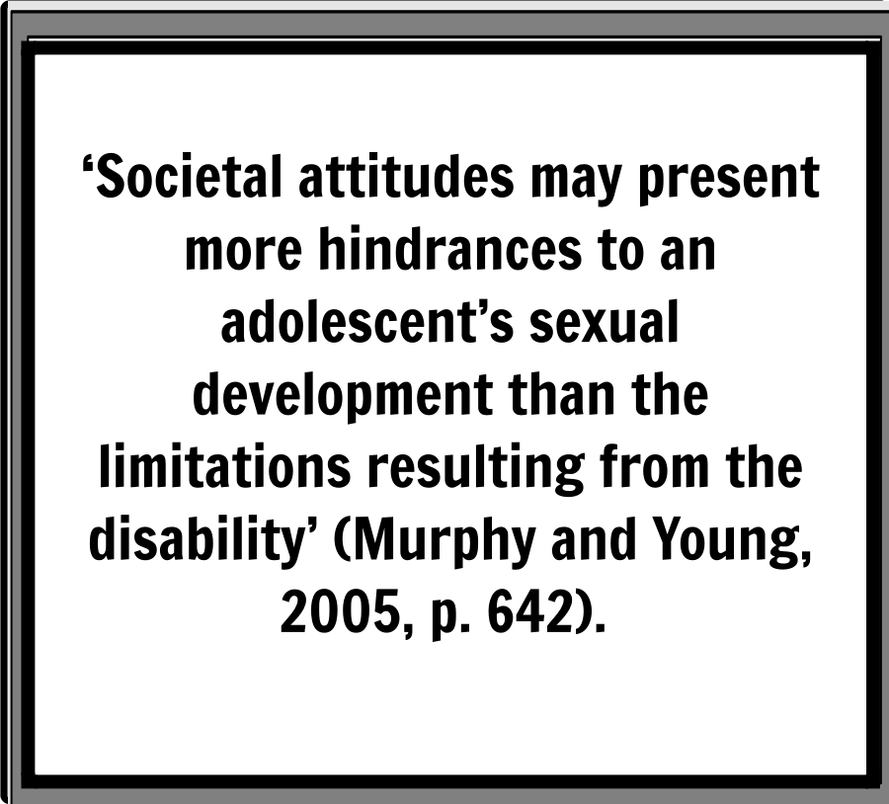
Ableism
Add Text Here

Slide 26
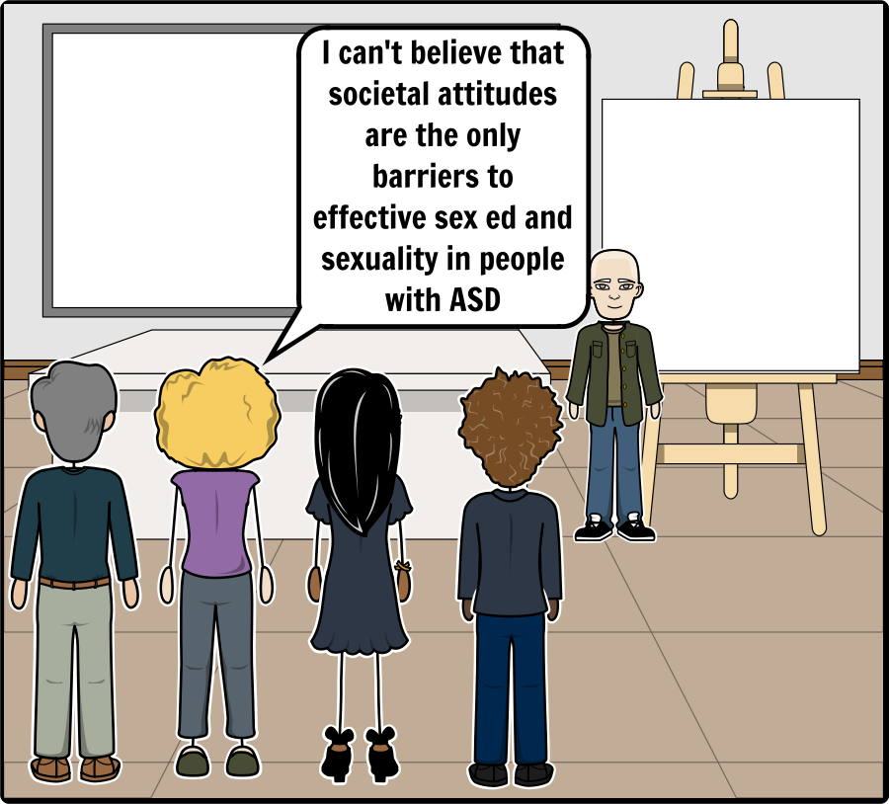
Other Extrinsic Factors
Add Text Here

Slide 27
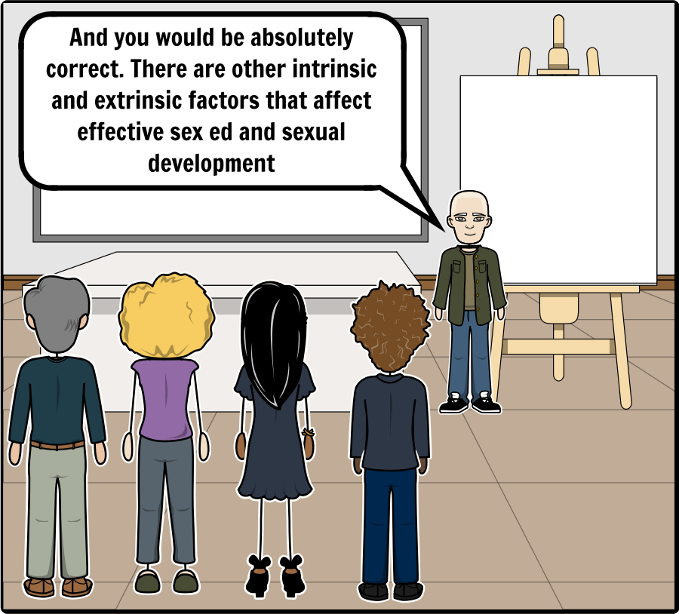
Other Extrinsic Factors
Add Text Here

Slide 28
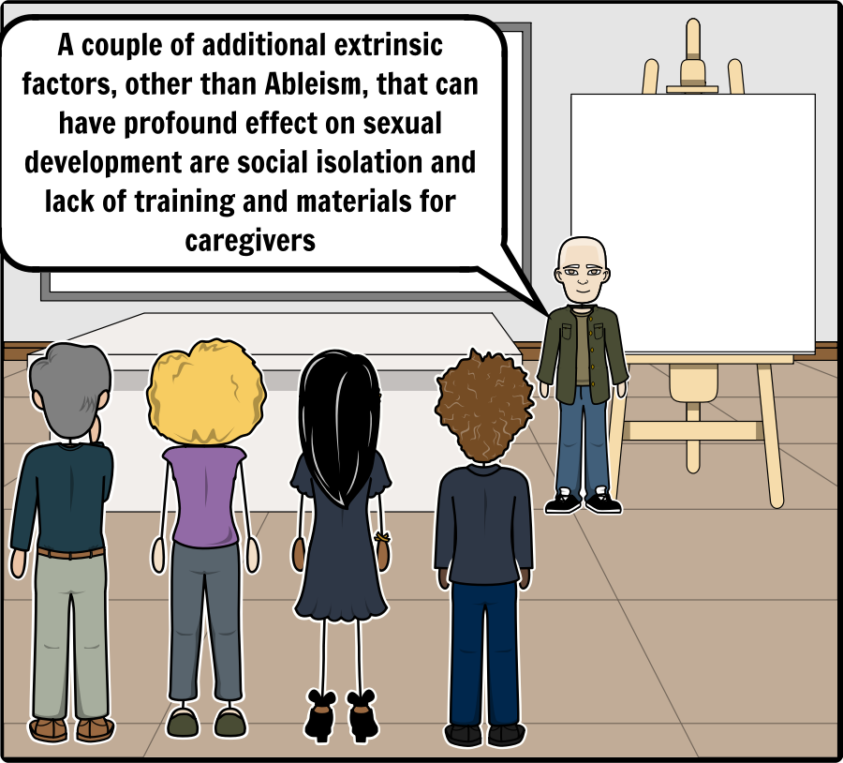
Other Extrinsic Factors
Add Text Here

Slide 29
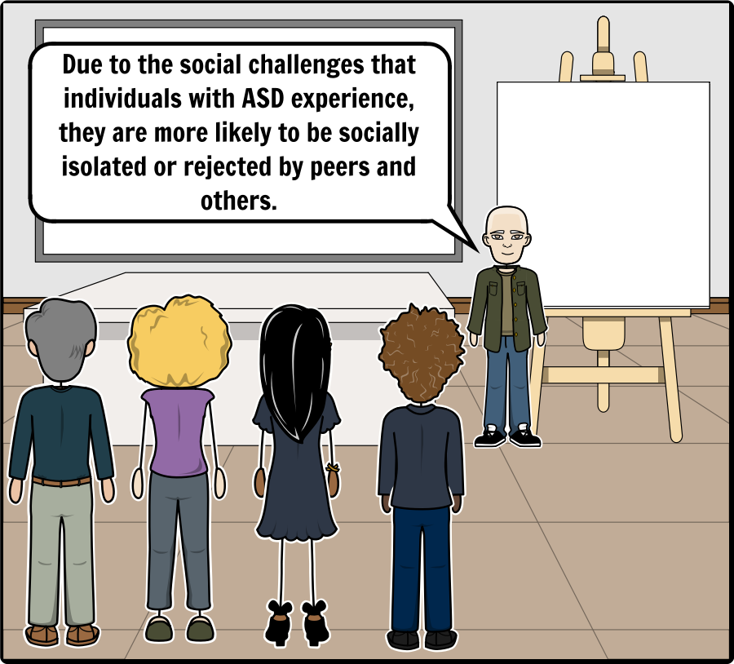
Other Extrinsic Factors
Add Text Here
In the current study, we found that individuals with ASD were less likely to report receiving knowledge from peers, parents, and teachers across all types of sexual knowledge(Brown‐Lavoie, Viecili, & Weiss, 2014)

Slide 30
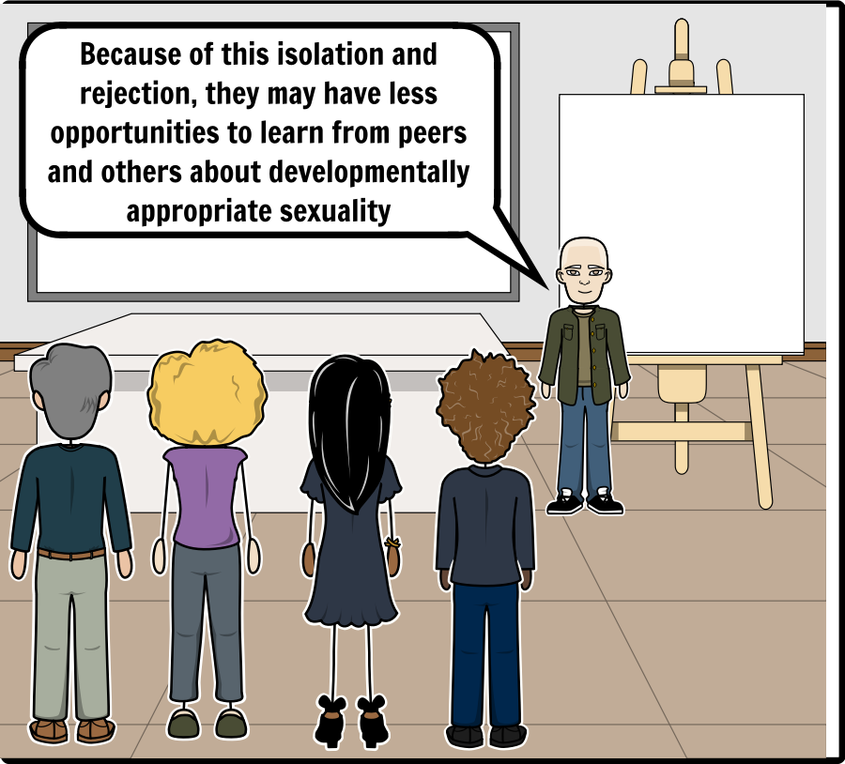
Other Extrinsic Factors
Add Text Here
Difficulties in understanding intentions, missing social subtleties, and limited peer interactions may lead individuals with ASD to be more likely to miss or misunderstand important sexual knowledge‐gaining opportunities (Hénault, 2005). (Brown‐Lavoie, Viecili, & Weiss, 2014)

Slide 31
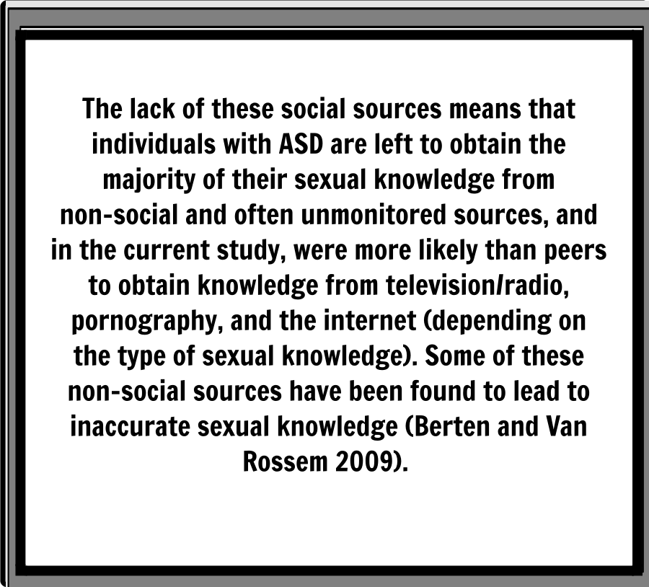
Other Extrinsic Factors
Add Text Here

Slide 32
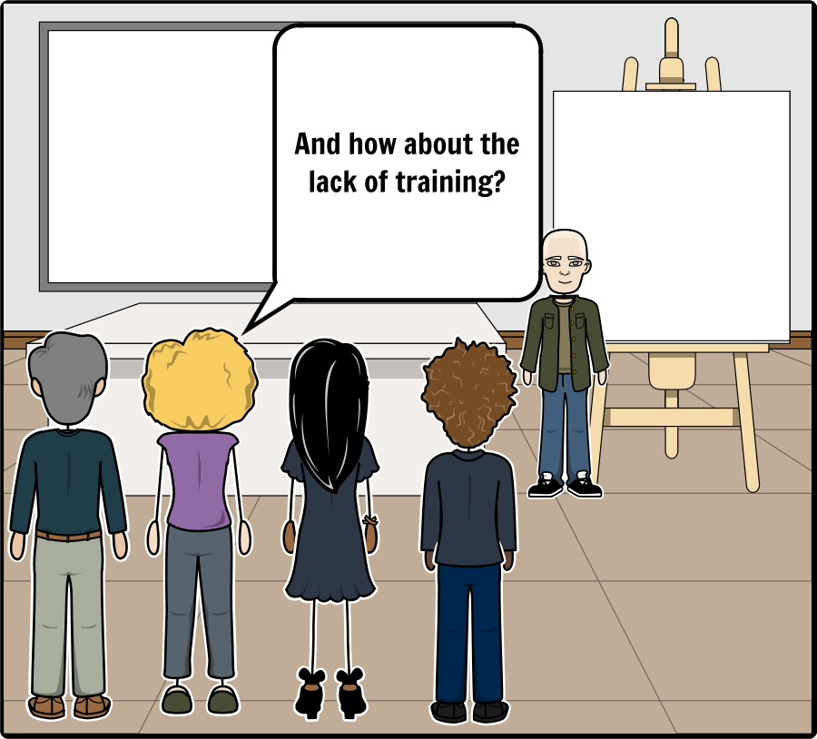
Other Extrinsic Factors
Add Text Here

Slide 33
Other Extrinsic Factors
Add Text Here
(Hartman, 2014): There is insufficient availability of suitable materials designed for parents, professionals or individuals themselves looking to support the development of a healthy sexuality and intimate relationships in children or adults with ASD (Ballan 2012; Hatton and Tector 2010; Tissot 2009).

Slide 34
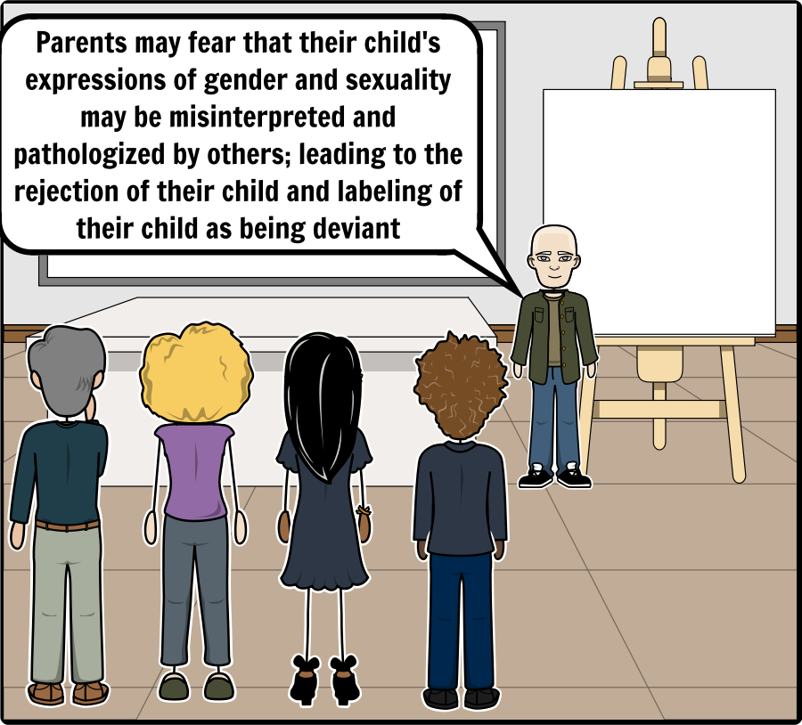
Other Extrinsic Factors
Add Text Here
Another area of concern that leads to resistance from parents may be that the parent perceives the sexual misconduct as non‐sexually motivated. They may not want the child to be "misdiagnosed" as sexually motivated. The parent may well acknowledge the problem behavior has occurred, but would prefer it was handled as any other behavior problem and without the attribution of sexual motivation. (Blasingame, 2011)

Slide 35
Other Extrinsic Factors
Add Text Here
Some parents are opposed to their ASD‐affected child being exposed to potential rejections and may overprotect their child. Other parents may wish to suppress their child's exposure to sexuality for religious reasons, from concern for their child's potential for inappropriate sexual behavior, or from fear their child may be taken advantage of. Yet other parents go to great lengths to create social opportunities for their child but the child may be totally disinterested (Rain, 2010). (Blasingame, 2011)

Slide 36
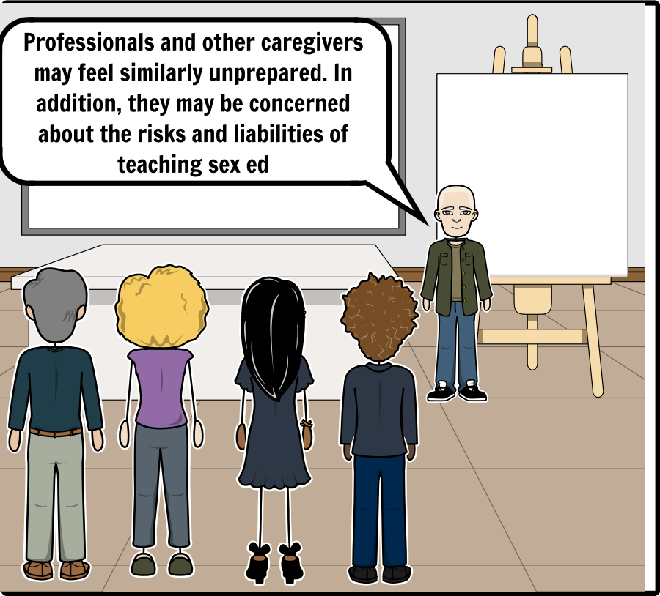
Other Extrinsic Factors
Add Text Here
The professional who has been designated to be the provider of the individual’s sexuality education may feel inadequate or hesitant for several reasons. He or she may feel uncomfortable discussing various aspects of sexuality with students. He or she may have religious, cultural, or personal beliefs that conflict with the situation. Despite such conflicts, professionals must remember their obligation to provide individuals with disabilities, including ASD, appropriate sexuality education. (Travers & Tincani, 2010)

Slide 37
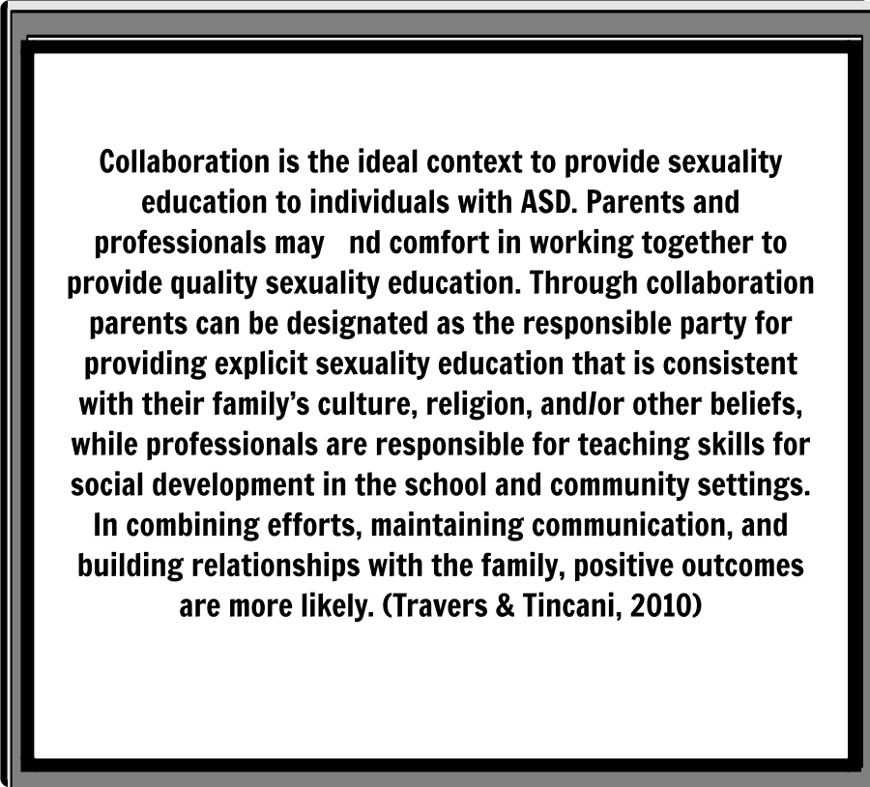
Other Extrinsic Factors
Add Text Here

Slide 38
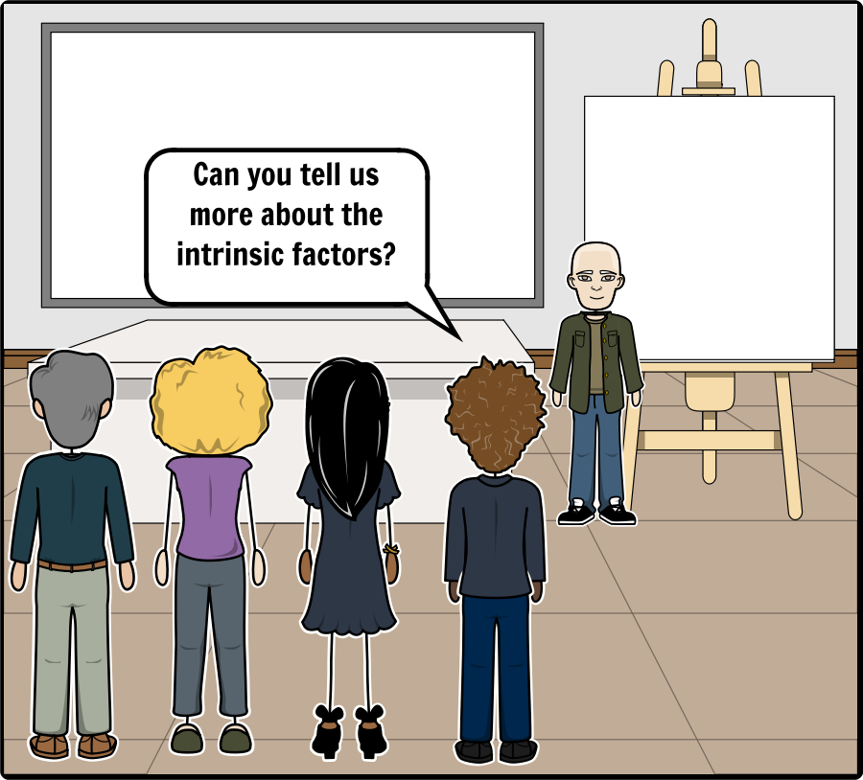
Intrinsic Factors
Add Text Here

Slide 39
Intrinsic Factors
Add Text Here

Slide 40
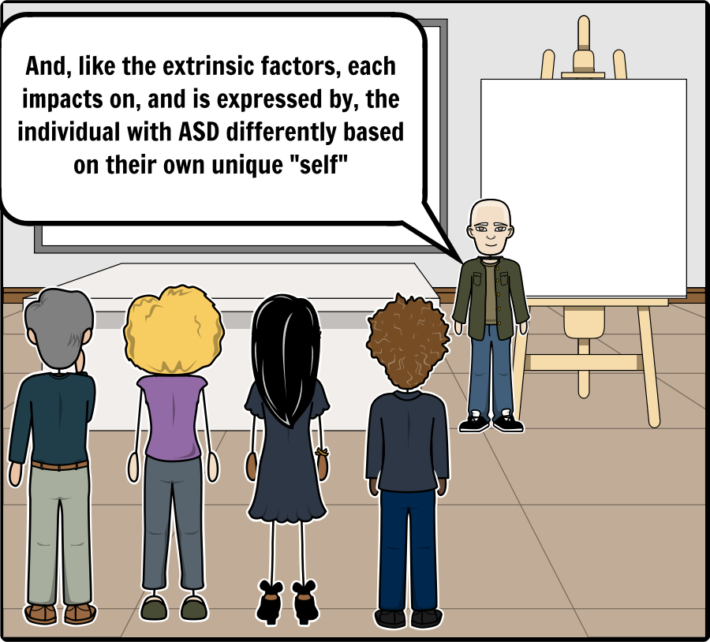
Intrinsic Factors
Add Text Here

Slide 41
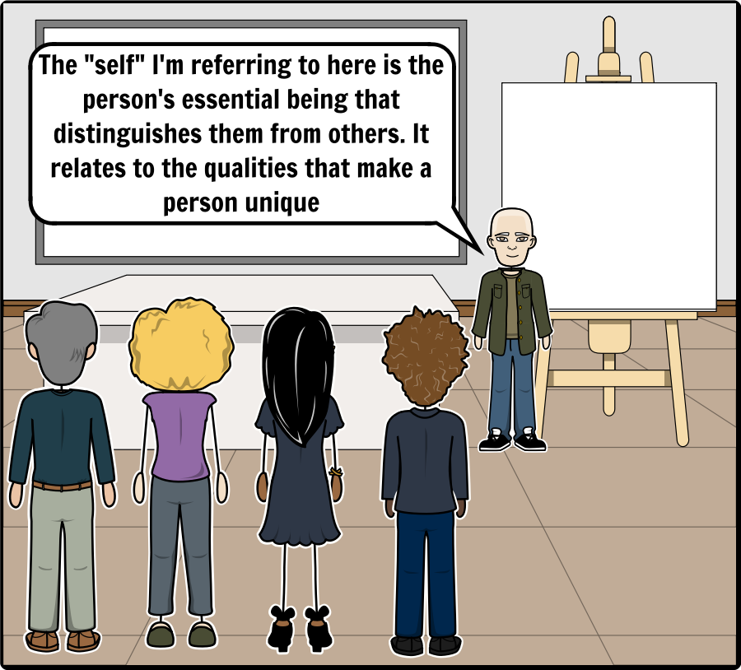
Intrinsic Factors
Add Text Here

Slide 42
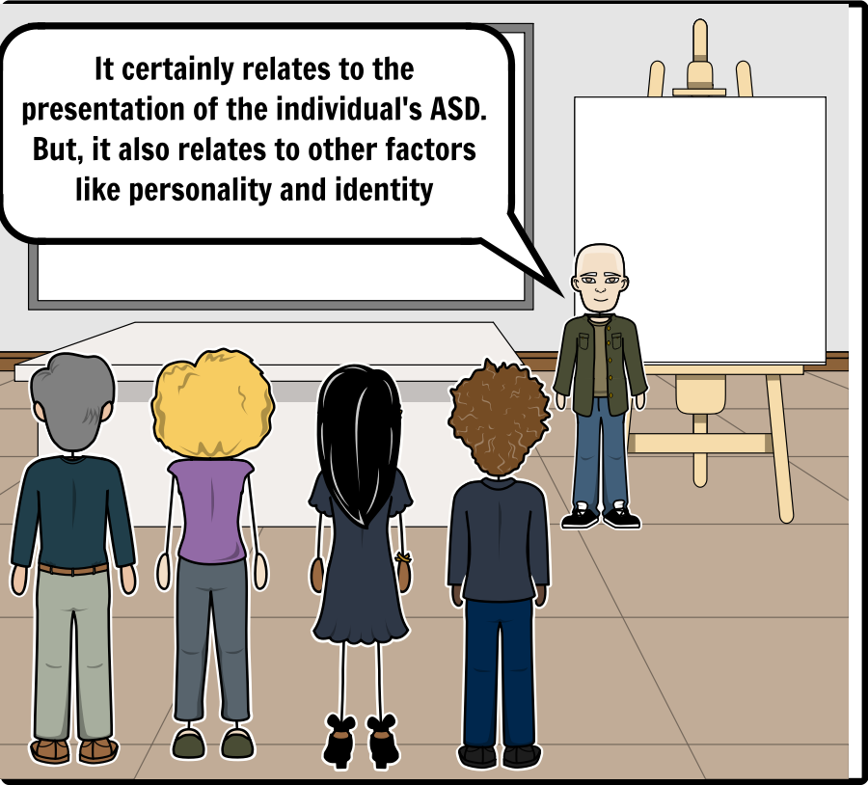
Intrinsic Factors
Add Text Here

Slide 43
Intrinsic Factors
Add Text Here

Slide 44
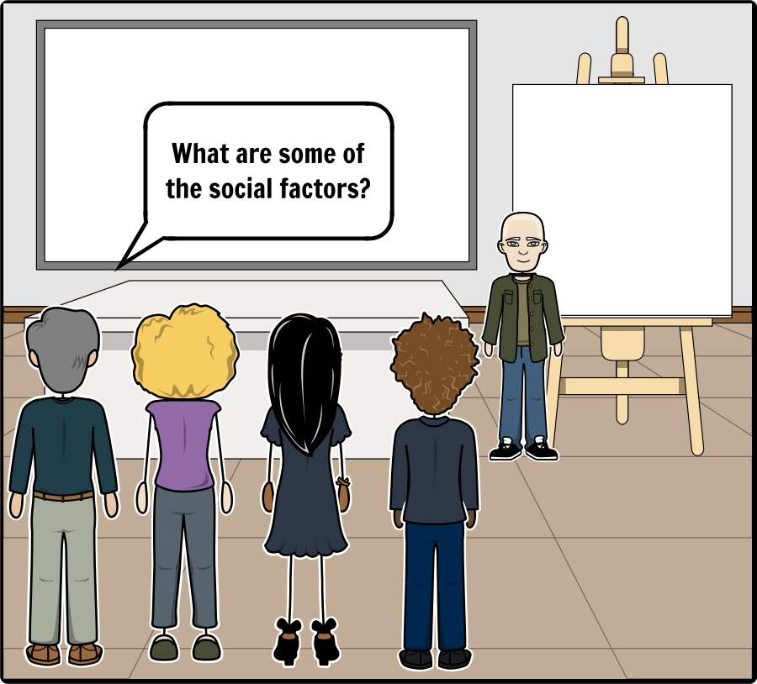
Intrinsic Factors
Add Text Here
Individuals develop at a faster rate biologically than they do socially and emotionally.

Slide 45
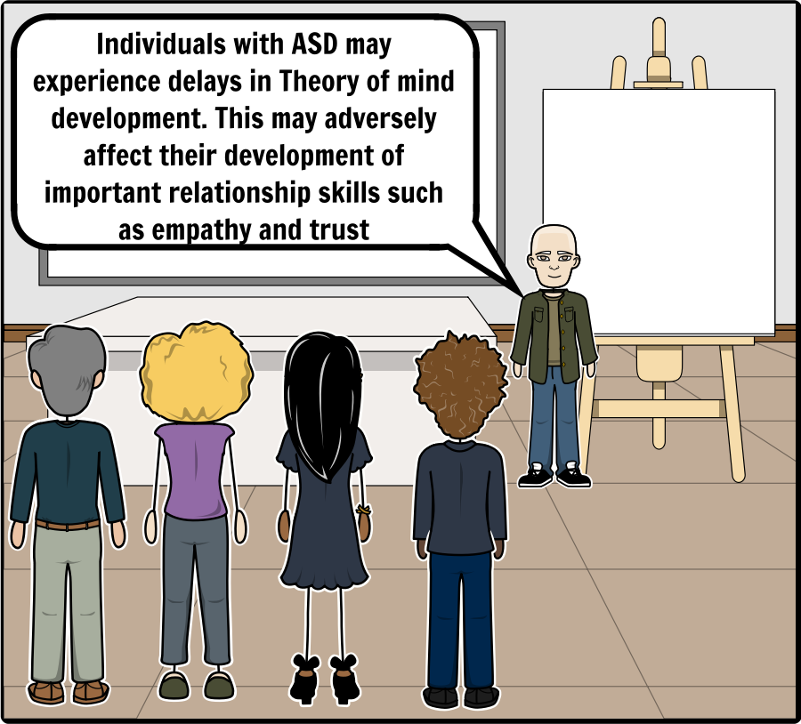
Intrinsic Factors
Add Text Here
From early childhood, people with Asperger’s syndrome are less likely to recognize and understand thoughts, beliefs, desires and intentions of other people in order to make sense of their behaviour. They are developmentally delayed in Theory of Mind abilities (Baron‐Cohen 1995). This will adversely affect the development of the important relationship skills of empathy, trust, and the ability to repair someone’s emotions and share thoughts and responsibilities (Attwood 2004) (Attwood T. , Relationship Problems of Adults with Asperger’s Syndrome , 2012)

Slide 46
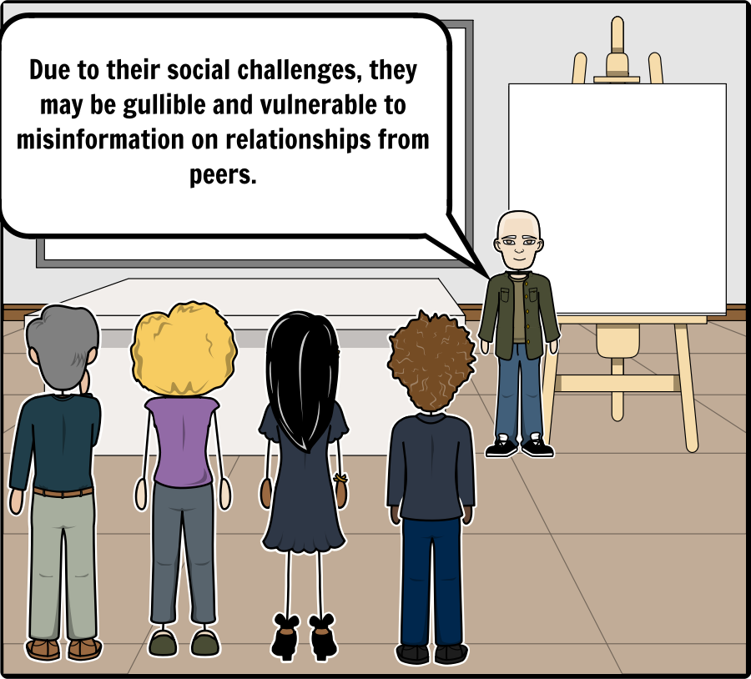
Intrinsic Factors
Add Text Here
This can include instances of being deceived and ‘set up’ which could lead the person with Asperger’s syndrome to be accused of inappropriate social or sexual behaviour. (Attwood T. , Relationship Problems of Adults with Asperger’s Syndrome , 2012)

Slide 47
Intrinsic Factors
Add Text Here
It is quite common for someone with autism to come on too strong too soon because we assume we have become friends with somebody and bombard them with compliments and invitations to events and want to hang out with them and discuss personal, intimate topics, only to discover they were only ever an acquaintance and now they think we’re weird. (Drew, 2017)

Slide 48
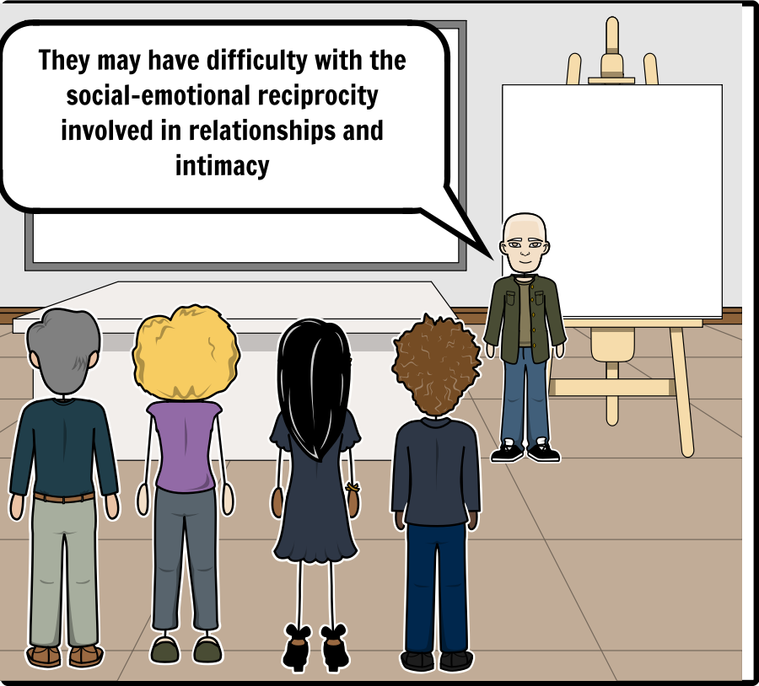
Intrinsic Factors
Add Text Here
May have difficulty spontaneously sharing thoughts, experiences and emotions with their partner, which may come across as being careless of partner’s feelings. (Drew, 2017)

Slide 49
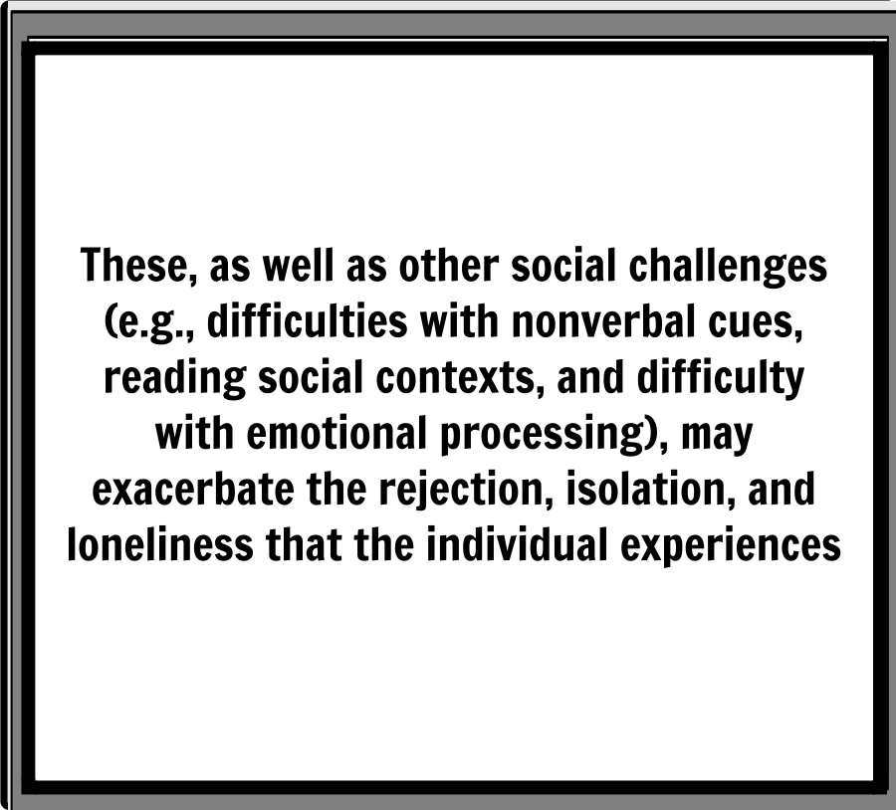
Intrinsic Factors
Add Text Here
They have difficulty understanding social proprieties and may act upon a variety of urges ‐ not just sexual ones ‐ in a setting not appropriate for that behavior. They also do not understand how they are coming across to others. Lacking in social perspective taking, many of these youth are insensitive to how their behavior affects others. Making a social or sexual faux pas only adds to their social isolation and discourages further experimentation with social behaviors, which interferes with the normal pathways of learning social and sexual boundaries. (Blasingame, 2011)

Slide 50
Intrinsic Factors
Add Text Here

Slide 51
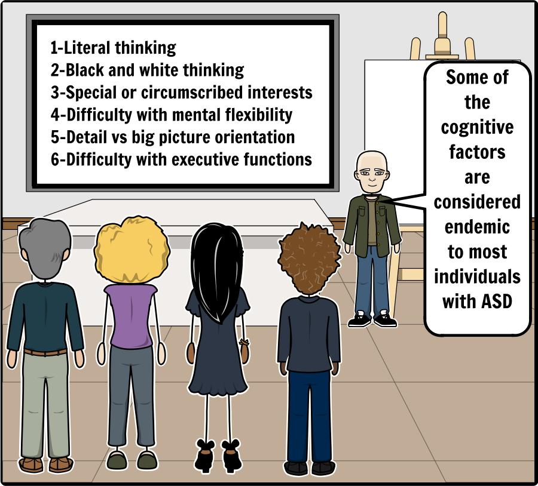
Intrinsic Factors
Add Text Here
Many with autism idealize the concept (of love), learning about it from books, television and movies and building it up into something with which reality cannot compete. (Drew, 2017)

Slide 52
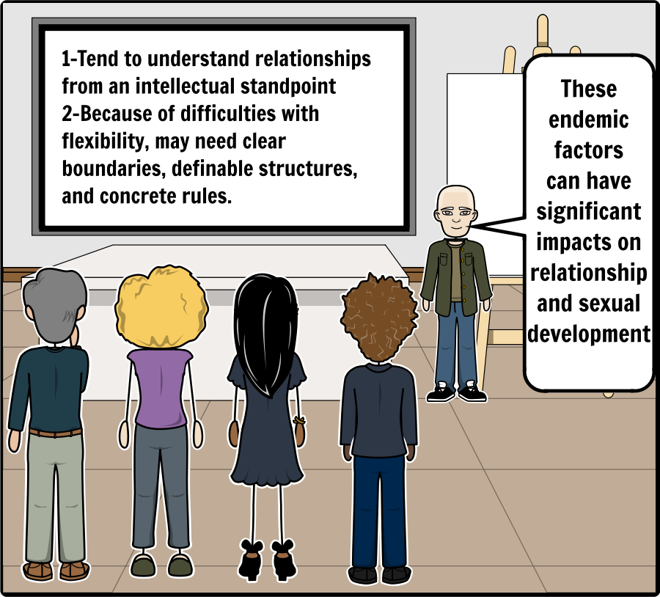
Intrinsic Factors
Add Text Here
Closely related to the above, most people with autism like clear boundaries, definable structures and concrete rules. Unfortunately, neither friendships nor romantic relationships come with manuals for anybody, neurotypical, autistic or otherwise. (Drew, 2017)

Slide 53
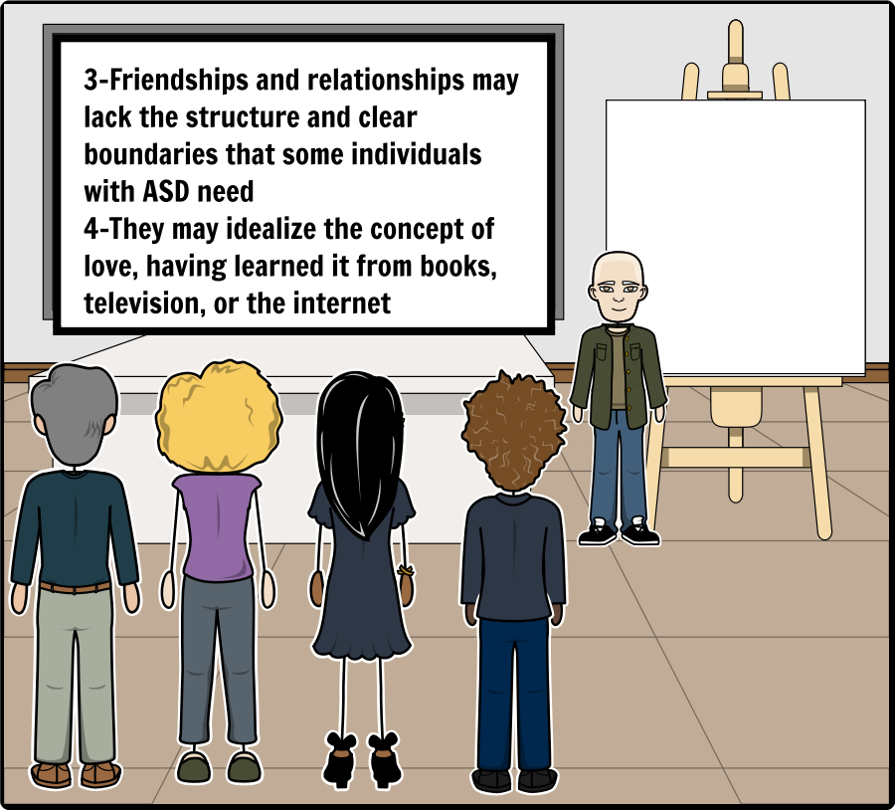
Intrinsic Factors
Add Text Here
We (NT’s) often have to ‘feel’ our way into relationships, whether friendly or romantic, moving slowly and subtly, in small steps and tiny incremental stages. They are intuitive, tacitly negotiated without ever being explicitly discussed, can last a few days to a lifetime, can be very intense very quickly or never get beyond a passing acquaintance, and are governed by rules and conventions that people naturally pick up as they grow and develop. (Drew, 2017)

Slide 54
Intrinsic Factors
Add Text Here
Lower intellectual functioning complicates the sex education process, but does not make it any less important. (Blasingame, 2011)

Slide 55
Intrinsic Factors
Add Text Here

Slide 56
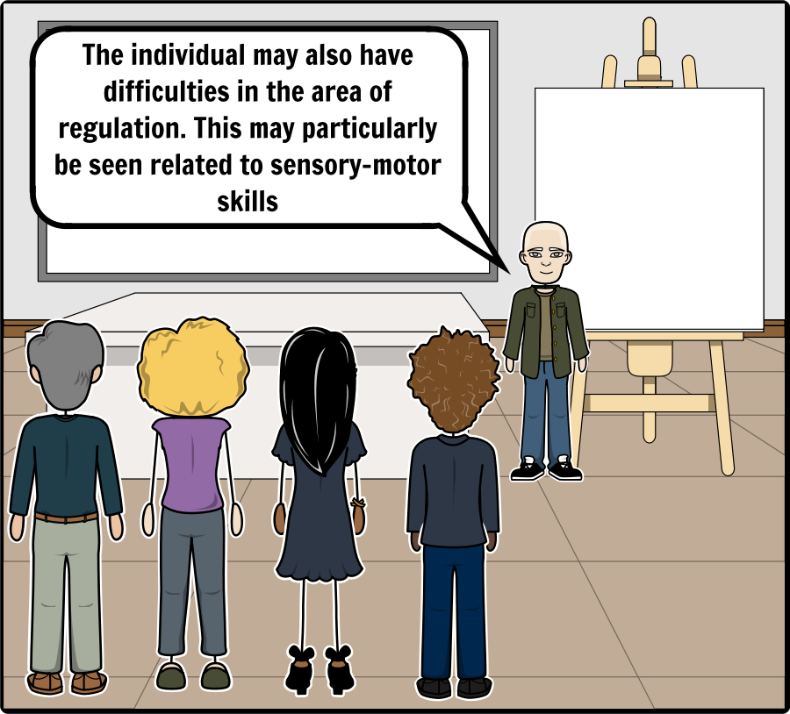
Intrinsic Factors
Add Text Here
For adolescents with SPD, already overloaded with uncomfortable clothes, overstimulating environments, baffling activities, and perhaps distasteful meals, kissing may be the last straw. (Kranowitz, 2016)

Slide 57
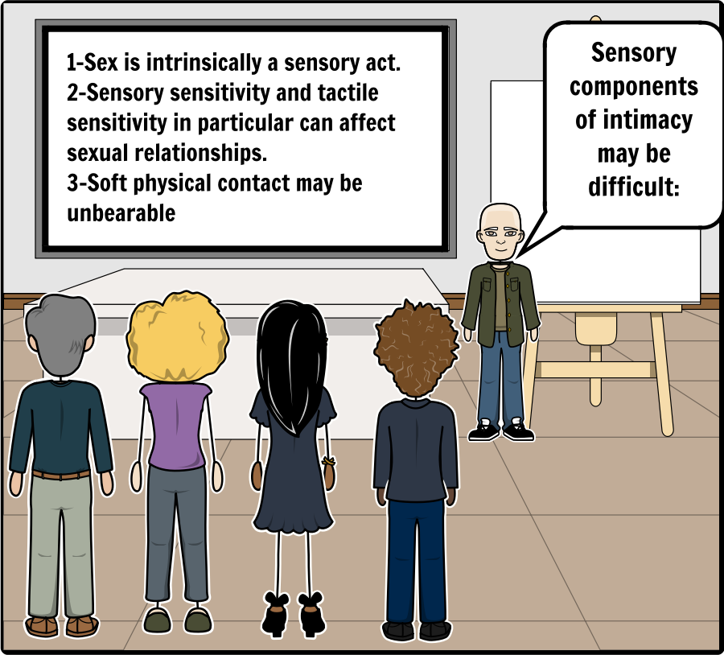
Intrinsic Factors
Add Text Here
Sex is intrinsically a sensory act. It involves sight, smell, taste, touch and sound. It often involves…the very close interaction of bodies against each other. For this reason it can be a potentially extremely pleasant or unpleasant experience for someone with ASD and sensory issues. (Heffernan, 2016)

Slide 58
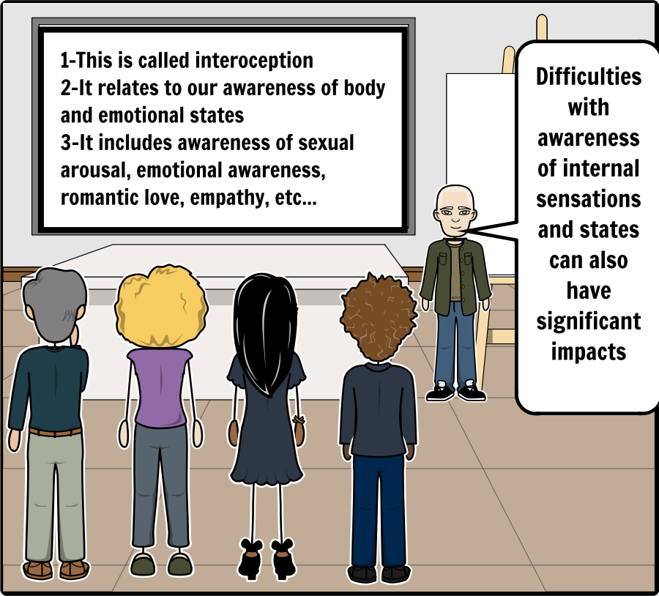
Intrinsic Factors
Add Text Here
Interoception allows us to experience many important feelings. For the purpose of simplification, these feelings will be divided into two main categories:
Body States. These involve the basic functions or physical conditions of the body. Body states include hunger, thirst, needing to go to the bathroom, pain, sexual arousal, itch, tickle, temperature (e.g., hot/ cold), nausea, headache, illness, muscle tension.
Emotion States. These involve our moods or emotional conditions of the body. Emotion states include anger, embarrassment, overwhelm, happiness, anxiety, excitement, sadness, fear.

Slide 59
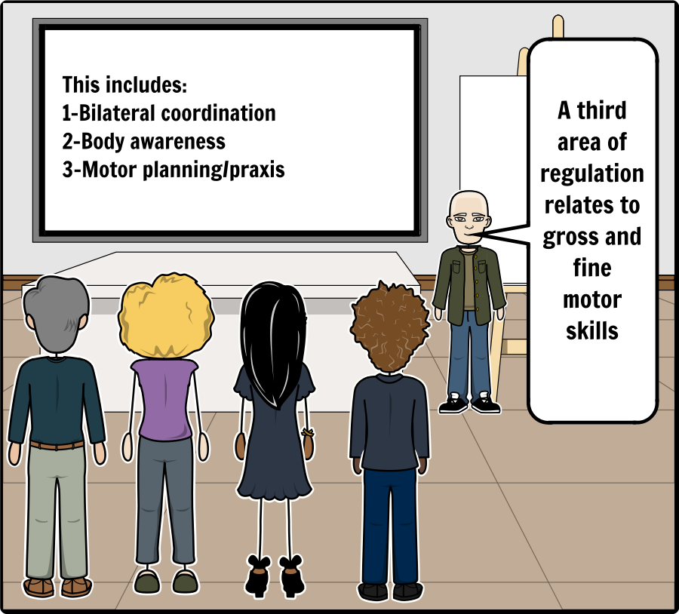
Intrinsic Factors
Add Text Here
Difficulties with gross and fine motor skills can lead to challenges with relationship and sexually related activities, such as:
Holding hands
Kissing
Intimacy
Intercourse

Slide 60
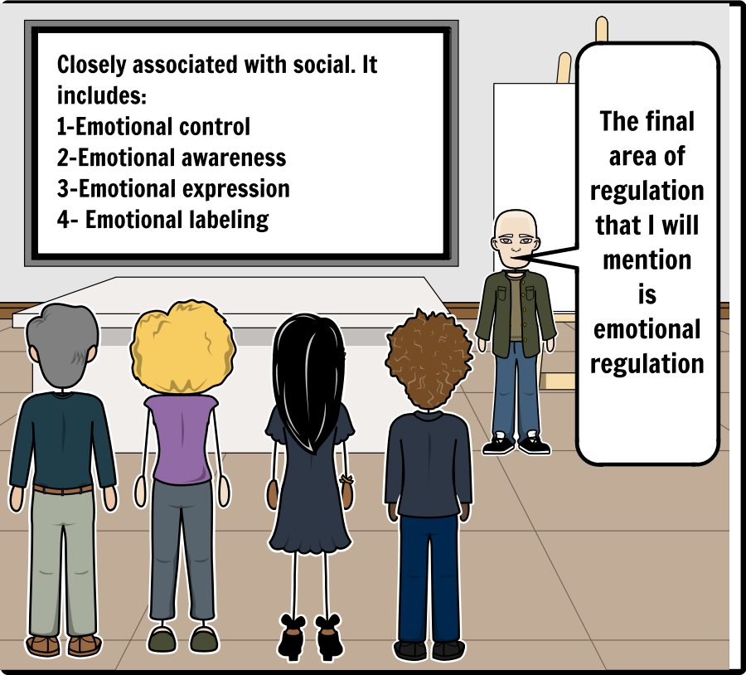
Intrinsic Factors
Add Text Here
Typical children and adults enjoy frequent expressions of affection, know how to express affection to communicate reciprocal feelings of adoration and when to repair someone’s feelings by expressions of affection. A child or adult with Asperger’s syndrome may not seek the same depth and frequency of expressions of love through acts of affection, or realize that an expression of affection is expected in a particular situation and would be enjoyed by the other person. (Attwood T. , Relationship Problems of Adults with Asperger’s Syndrome , 2012)

Slide 61
Intrinsic Factors
Add Text Here

Slide 62
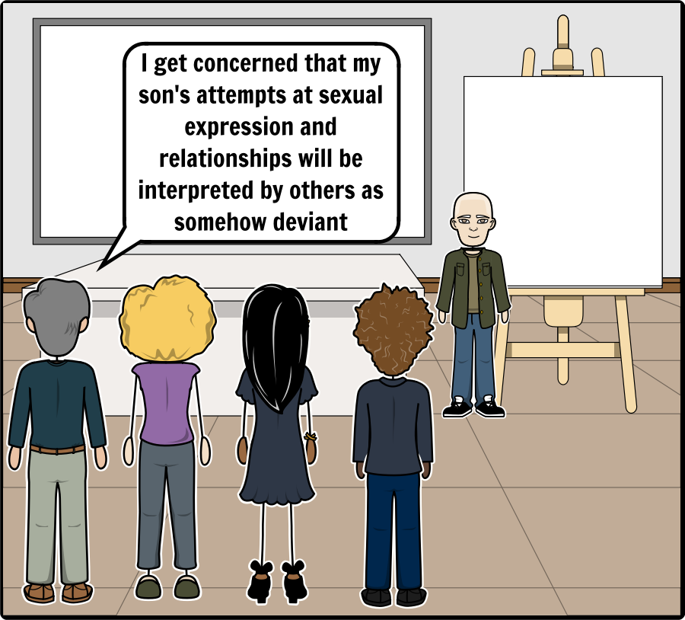
Intrinsic Factors
Add Text Here

Slide 63
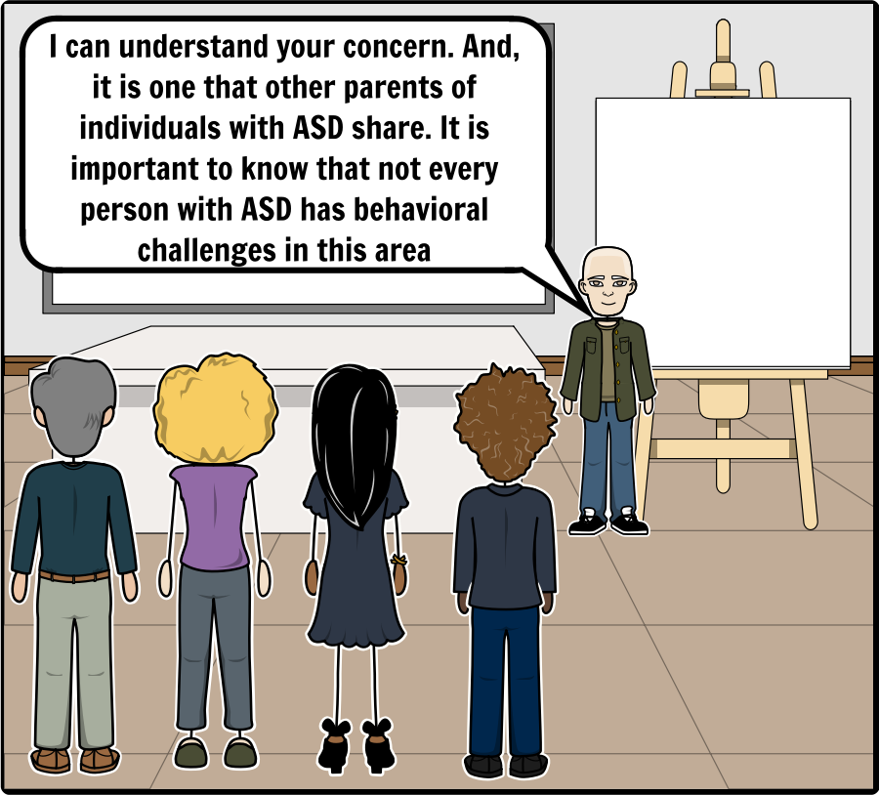
Intrinsic Factors
Add Text Here

Slide 64
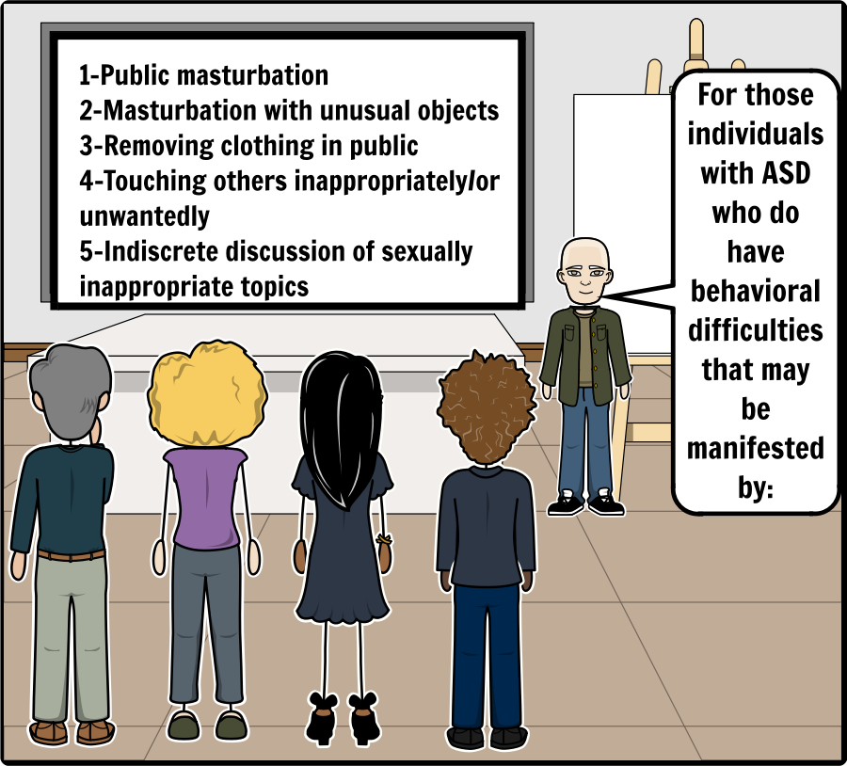
Intrinsic Factors
Add Text Here
Another source of inappropriate sexual behavior is the fact that individuals with AS have a propensity for repetitive and ritualistic activities. While this part of their behavioral repertoire makes them feel safe, it may become problematic when sexuality becomes their special circumscribed interest. If it is a source of pleasure and satisfaction, it is then difficult to curb, modify, or restrain this interest. (Attwood, Henault, & Dubin, The Autism Spectrum, Sexuality and the Law: What every parent and professional needs to know, 2014)—Henault

Slide 65
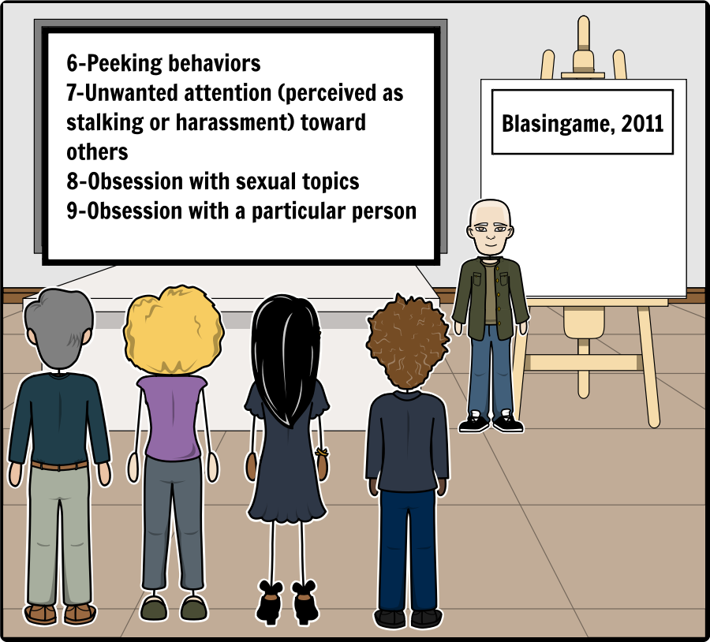
Intrinsic Factors
Add Text Here
Frustrations may be expressed as inappropriate or aggressive behaviors. Adolescents with AS commonly misunderstand requests that are made of them. It is also difficult for them to detect or express their own internal processes (hormonal variation, conflicting emotions, mood changes, etc.). Such situations may bring about confusion and frustration which are often expressed as inappropriate behavior. These impulsive reactions frequently become the only vehicle by which internal tensions are released. (Henault, Healthy Sexuality: Adaptive Skills for Individuals with Asperger's Syndrome, 2016)

Slide 66
Intrinsic Factors
Add Text Here
(Sullivan & Caterino, 2008): There is also a great deal of concern regarding the high risk of sexual victimization for this population. As many as 16 to 25% of persons with autism have been sexually abused.

Slide 67
Intrinsic Factors
Add Text Here
A functional behavior analysis (FBA) is the first step of behavioral intervention. It serves to determine the antecedents to the behavior of interest. Antecedents are the circumstances that precede the acting out behavior. (Blasingame, 2011)

Slide 68
Gender Identity
Add Text Here
The term identity comes from the Latin noun “identitas,” which means the same. The term, referring to a person's mental image of him or herself thus implies some sameness with others in a particular way. Each individual may have a number of identities, such as an ethnic identity, a religious identity, or a national identity. (Steensma, Kreukels, de Vries, & Cohen‐Kettenis, 2013)

Slide 69
Gender Identity
Add Text Here
(Steensma, Kreukels, de Vries, & Cohen‐Kettenis, 2013): A very fundamental identity, however, is one's gender identity. Gender identity refers to the extent to which a person experiences oneself to be like others of one gender. One's sense of being male or female largely determines how people view themselves and provides an important basis for their interactions with others.

Slide 70
Gender Identity
Add Text Here
The subjects diagnosed with ASD were 7.76 times more likely to report GV (gender variance) than the (control) sample. (Janssen, Huang, & Duncan, 2016)

Slide 71
Gender Identity
Add Text Here
Adolescents with AS are less attuned to social rules and do not feel the same pressures to belong to or affiliate with any particular group. Their tendency to isolate themselves can become a source of conflict if the Individuals with AS has no bearings with respect to a sense of belonging. (Henault, Healthy Sexuality: Adaptive Skills for Individuals with Asperger's Syndrome, 2016)

Slide 72
Gender Identity
Add Text Here

Slide 73
Gender Identity
Add Text Here

Slide 74
Intervention
Add Text Here
General Principles for Intervention (Blasingame, 2011)
Early, and ongoing, intervention
Be specific, clear, and explicit
Be consistent about relationship and sexual health and safety
Address social aspects of relationships and sexual health
Teach in real‐life contexts

Slide 75
Intervention
Add Text Here
People with ASD require specialized instruction and behavioral intervention that considers their unique strengths, weaknesses, preferences, and interests in order to address the priorities of all stakeholders, including the person with ASD. (Travers & Whitby, 2014)

Slide 76
Intervention
Add Text Here

Slide 77
Intervention
Add Text Here

Slide 78
Intervention
Add Text Here

Slide 79
Intervention
Add Text Here
(Travers & Tincani, 2010) (Blasingame, 2011)

Slide 80
Intervention
Add Text Here
Take the Time to Build Rapport: Don't forget to put time into building rapport and a good relationship with the (individual). Establishing rapport implies that two people want to interact with each other. (Hartman, 2014)

Slide 81
Intervention
Add Text Here
The approach with the largest body of evidence of effectiveness for people with ASD is rooted in applied behavior analysis (National Autism Center, 2009; National Professional Development Center on Autism Spectrum Disorders, n.d.). Behavior analytic interventions include but are not limited to functional communication training, task analysis, time delay, video modeling, prompting and fading prompts, reinforcement, visual supports, shaping, and response interruption. (Travers & Whitby, 2014)

Slide 82
Intervention
Add Text Here
The use of short written stories or picture stories is a great way of supporting all areas of an SRE programme. These stories are used to aid understanding, but can also instruct the child as to how to handle different social (Hartman, 2014)
Adult example of stories: Books Beyond Words

Slide 83
Intervention
Add Text Here
The goals of any good SRE programme should include promoting positive and prosocial adaptive behaviours, maximizing integration, increasing self‐understanding, self‐esteem and self-determination, encouraging independence in making healthy sexual choices, and replacing inappropriate behaviours with more prosocial behaviours that serve the same function. (Hartman, 2014)

Slide 84
Intervention
Add Text Here
Circles: The Circles® VideoModeling® Curriculum teaches social and relationship boundaries, interpersonal skills and relationship-specific social skills, using a simple multi-layer circle diagram to demonstrate the different relationship levels students will encounter in daily life.

Slide 85
Intervention
Add Text Here

Slide 86
Wrap Up
Add Text Here

Slide 87
Wrap Up
Add Text Here

Slide 88
Wrap Up
Add Text Here

Slide 89
Wrap Up
Add Text Here

Slide 90
Wrap Up
Add Text Here

Slide 91
Wrap Up
Add Text Here

